Slide 1
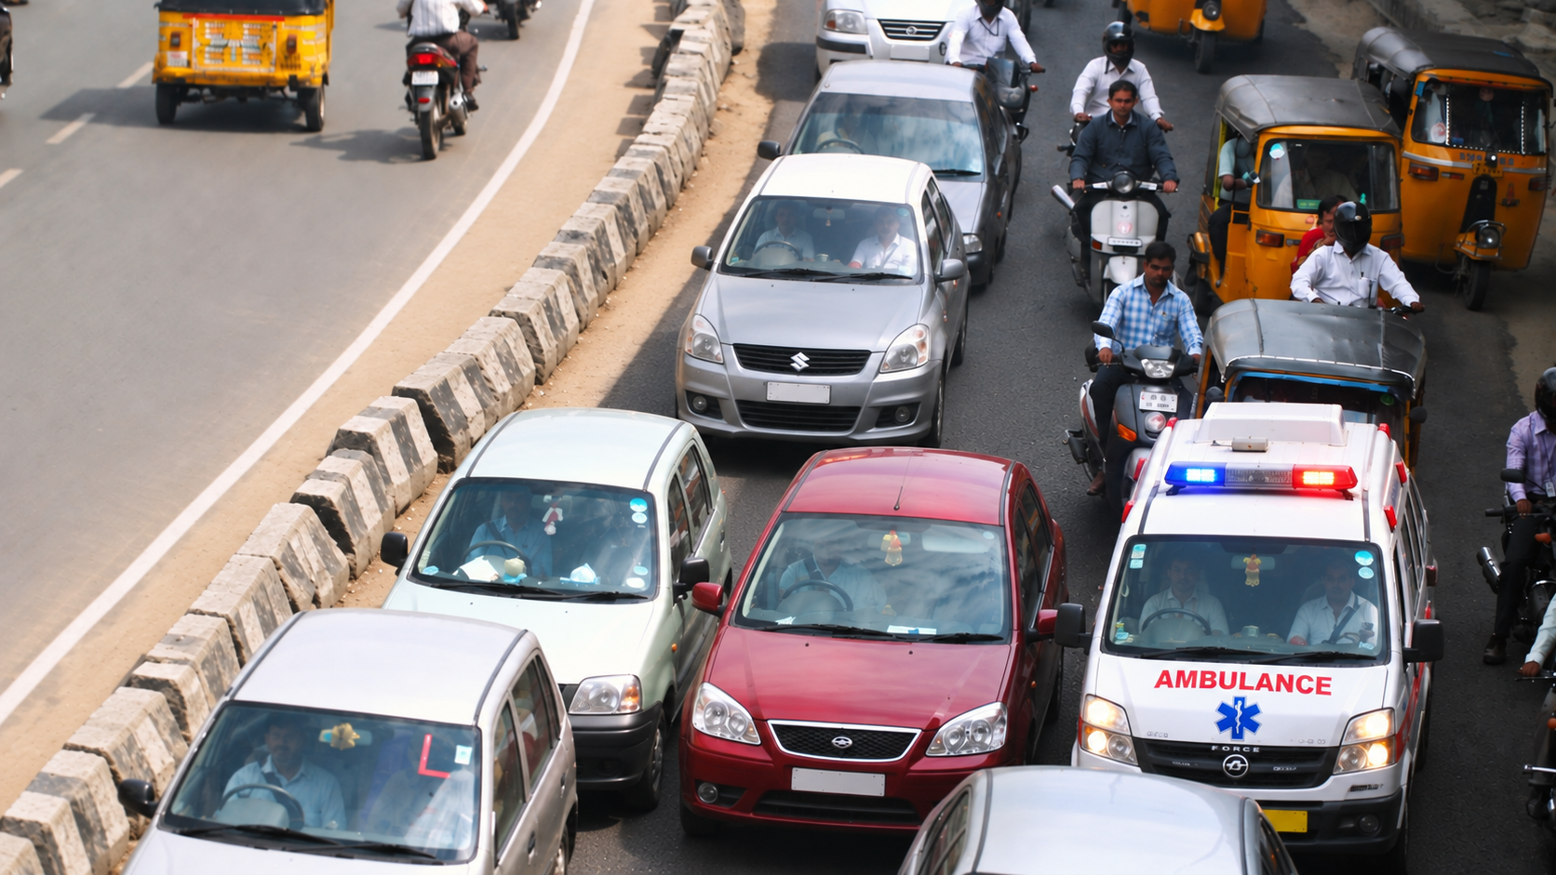
School Innovation Ideathon — PanIIT Andhra Pradesh Summit 2026
Smart Ambulance Traffic Signal System
01 — Traffic & Urban Mobility
Presented by:
Malavath Rithvik (10th CS)
Kuncham Hadvitha (9th VSB)
Chatla Bala Thrushna Dattu (9th AR)
SPR High School, Kamareddy

Slide 2
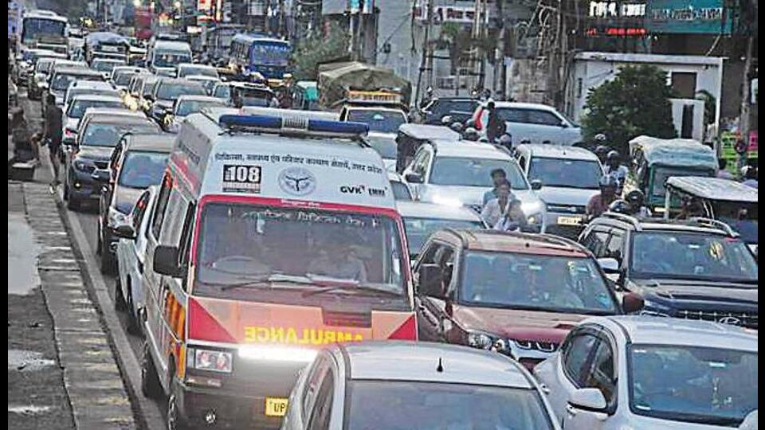
The Problem
WHAT IS THE PROBLEM?
Ambulances can lose critical time at multiple stages — from identifying the emergency location and reaching the patient to transporting the patient to a suitable hospital.
WHERE DOES IT HAPPEN?
Heavy and unpredictable traffic
Traffic signals and blocked intersections
Unfamiliar or unclear accident locations
Railway crossings and road bottlenecks
Queues beyond individual junctions
Changing traffic conditions on the hospital route
WHO IS AFFECTED?
Emergency patients
Accident victims
Ambulance crews
Emergency medical services
Hospitals receiving critical patients
An ambulance struck in traffic

Slide 3
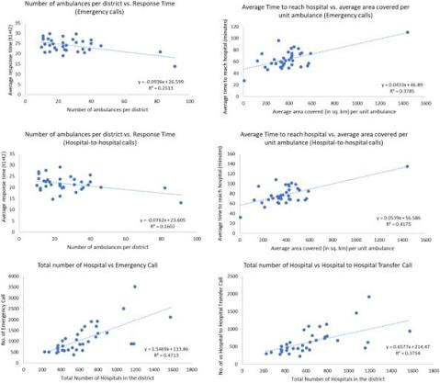
Evidence & Research
Maharashtra EMS Study — 38,823 records
23.15 min — Average Base → Scene time
12.12 min — Scene assessment
39.41 min — Average Scene → Hospital time
10.85 min — Hospital handover
Emergency response is a multi-stage process
Delays occur before reaching the patient and during hospital transport
Ambulance delay is not limited to traffic signals — it can occur throughout the emergency journey.
-Source: Scientific Reports — Nature, 2023.
Maharashtra EMS study

Slide 4
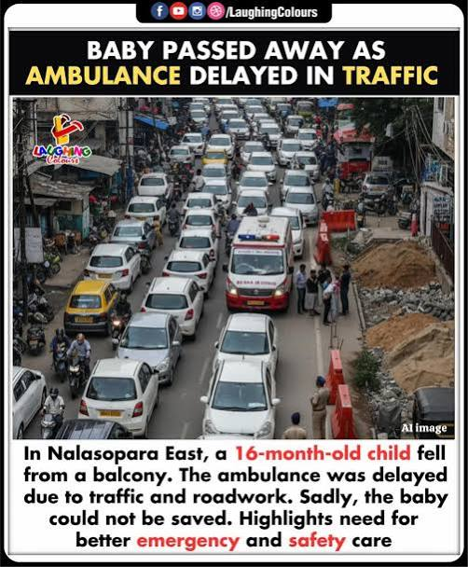
Evidence & Research
INDIAN HIGHWAY EVIDENCE
A separate survey of 225 participants found:
~90% successfully contacted an ambulance service
Only ~72–78% reported successful ambulance arrival at the accident scene
25–35 min ambulance arrival time on core highways
15–25 min transport time to nearby hospitals
PubMed
Mumbai: One in 10 patients in India dies on the way to hospital, simply because motorists are clueless about what to do when they see an ambulance on the road, according to the Radhee Disaster and Education Foundation.
Radhee Foundation

Slide 5
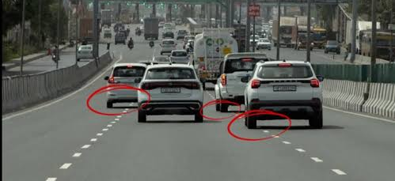
Root Cause Analysis
Root Cause
Peak Traffic Density: High vehicle volume during rush hours creates gridlocks where ambulances physically cannot pass.
Poor Lane Discipline & Blind Spots: Drivers frequently fail to follow lane rules, blocking emergency paths or missing approaching sirens due to cabin noise and blind spots.
Fixed-Timer Signals: Conventional junctions operate on static, un-synchronized timers that cannot detect or prioritize emergency transit.
Lacking of lane discipline
Who is responsible to this?
Past Attempts and System gaps
Civic Behavior & Infrastructure: A combination of limited public road awareness regarding yielding and a lack of automated, smart traffic management systems.
Enforcement Deficit: Absence of automated deterrents (like real-time e-challans) for non-yielding drivers during emergency passage.
Manual Traffic Override: Traffic police cannot be stationed at every junction 24/7 to manually override signal phases during sudden medical emergencies.
Siren Dependency: Sirens rely entirely on manual driver cooperation, which fails in high-density or multi-lane traffic without automated signal assistance.

Slide 6
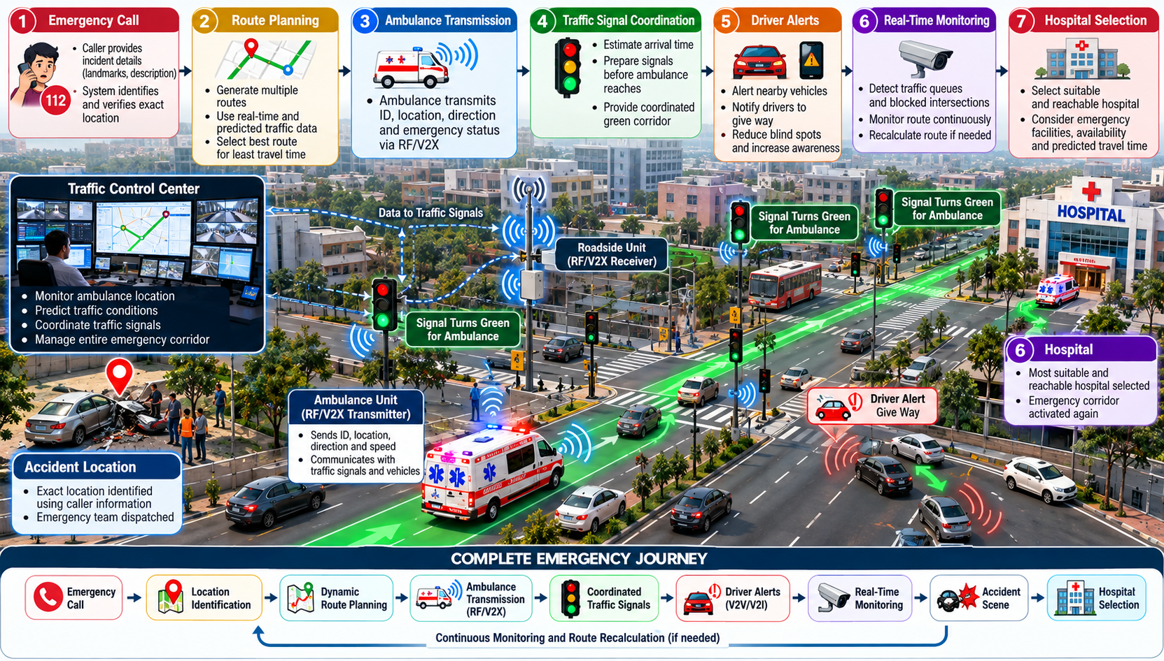
The Core Idea
The Solution
An AI-assisted, hybrid software-and-hardware system that creates a Dynamic Emergency Corridor for ambulances.
It combines GPS/GIS, dynamic route planning, traffic prediction, RF/V2X communication, driver alerts and coordinated traffic signals to support the ambulance from the emergency call to the hospital.
HOW THE SOLUTION WORKS
1. Emergency Location Identification
Identify and verify the incident location using caller information, landmarks and available location data.
2. Dynamic Route Planning
Generate multiple routes and select a suitable route using current and predicted traffic conditions.
3. Dynamic Emergency Corridor
Create a coordinated corridor along the ambulance's predicted route.
4. RF / V2X Communication
The ambulance transmits its emergency status, position and direction to traffic infrastructure and, in the future, connected vehicles.
5. ETA-Based Signal Coordination
Estimate the ambulance's arrival time and prepare upcoming traffic signals before it reaches them.
6. Driver Alerts & Traffic Monitoring
Alert nearby road users and monitor queues, blocked intersections and changing traffic conditions.
7. Route Recalculation
If unexpected congestion or blockage occurs, reassess the route and select an alternative when appropriate.
8. Hospital Journey
After reaching the accident scene, select a suitable and reachable hospital and activate the emergency corridor again.

Slide 7
Feasibility & Implementation
Signal Spoofing
Use unique ambulance identification and authenticated communication
Allow signal priority only for verified emergency vehicles
Signal Interference
Use reliable communication protocols and receiver calibration
Monitor for false or repeated signals
Changing Traffic Conditions
Continuously monitor the route
Recalculate the route when major congestion or blockage is detected
Key Risks & Mitigation
Required Resources
433 MHz RF modules for the working prototype
Microcontrollers, relays and traffic-signal components
GPS/GIS and communication systems for the future implementation
Traffic sensors/cameras for monitoring congestion and blockages
Technical support for roadside installation, calibration and maintenance
Local Implementation (Kamareddy District)
Phase 1 — Prototype
RF transmitter + receiver + microcontroller + traffic-light model
Phase 2 — Controlled Pilot
Test at selected junctions with emergency-service coordination
Phase 3 — Connected System
Integrate V2X, traffic monitoring, driver alerts and multiple-junction coordination
Phase 4 — Dynamic Emergency Corridor
Extend coordination from emergency call → accident scene → hospital
Key Stakeholders & Permissions
Traffic Police
Emergency Medical Services
Road & traffic-management authorities
Municipal/local authorities
Hospitals
Technology and maintenance teams

Slide 8
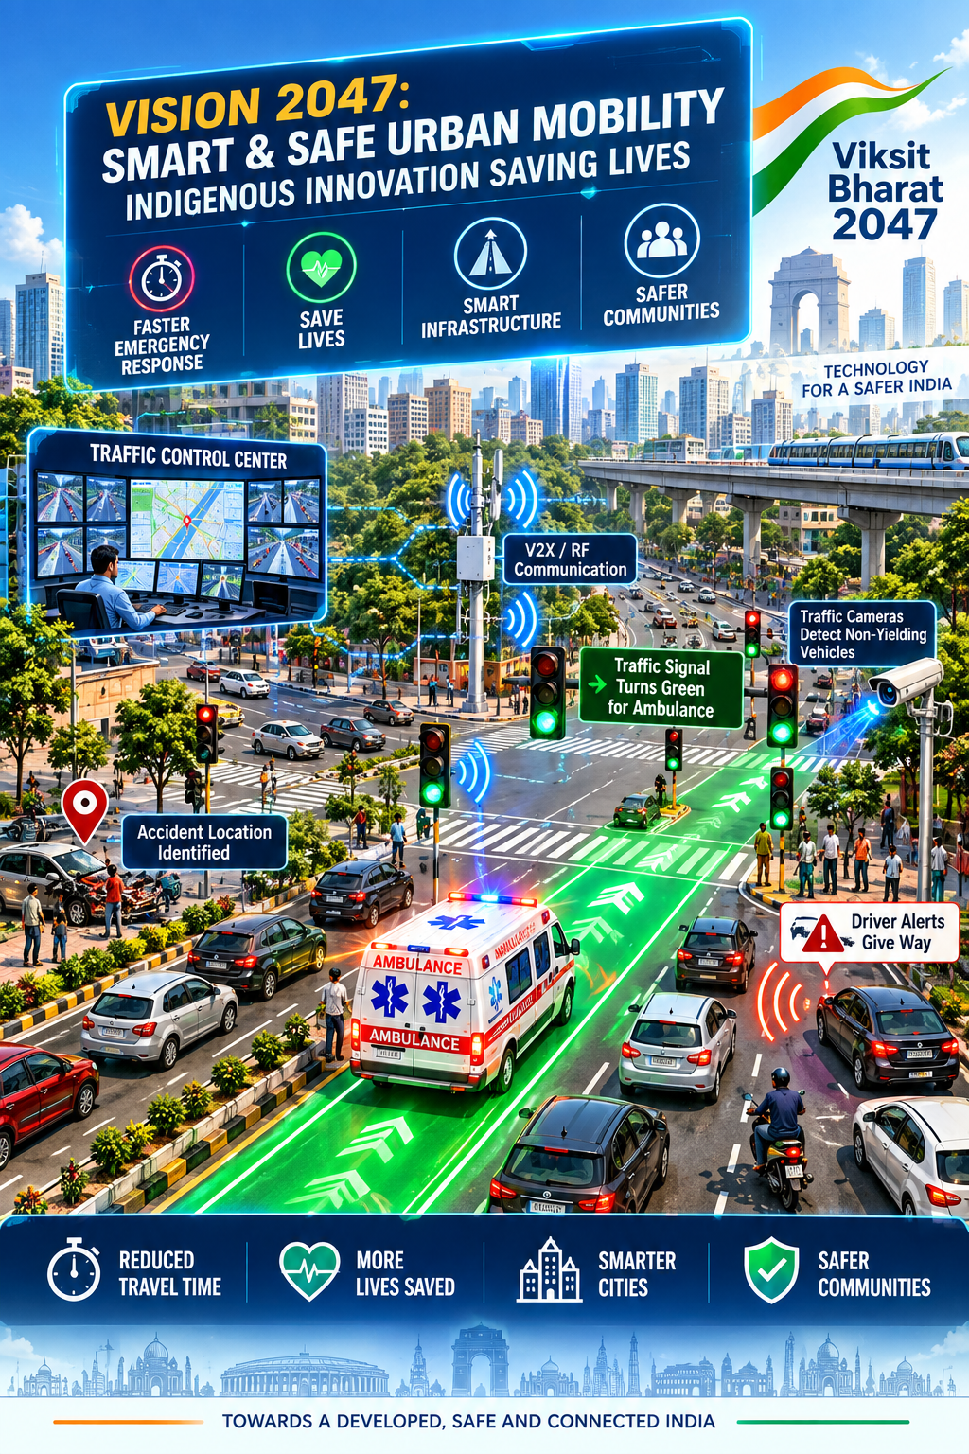
Local Impact & Vision 2047
MEASURABLE COMMUNITY BENEFITS
Reduced Emergency Travel Time: Minimize avoidable delays at traffic signals, congested roads and blocked intersections.
Faster Emergency Access: Help ambulances reach accident scenes and suitable hospitals more efficiently.
Safer Road Priority: Alert nearby drivers and coordinate traffic signals to create a safer emergency corridor.
Low-Cost Scalability: Use affordable RF-based hardware for the prototype, with future expansion to V2X technology.
BUILDING A SMARTER & SAFER INDIA
Smart Urban Infrastructure: Support intelligent and connected traffic-management systems.
Equitable Emergency Healthcare: Improve emergency mobility beyond major metropolitan areas.
Connected Transportation: Link ambulances, traffic signals, roadside infrastructure and connected vehicles.
Indigenous Innovation: Demonstrate how locally developed, affordable technology can address real transportation challenges.
How does it contribute to Vision 2047?

Slide 9
References & Credits
1. Maharashtra Emergency Medical Services — Scientific Reports (2023)
Scientific Reports — Maharashtra EMS Study
2. Indian National Highways — Ambulance Reachability Study (2024)
PubMed — Indian Highway Ambulance Study
3. National Ambulance Services Guidelines — Government of India (2026)
PIB — National Ambulance Services Guidelines 2026
4. C-DAC — Emergency Service Vehicle Priority System (EmSerV)
C-DAC — EmSerV Emergency Vehicle Priority System
5. Singapore Traffic Priority System — SCDF Annual Statistics 2025
SCDF — Annual Statistics 2025
6. U.S. Emergency Vehicle Signal Pre-emption — FHWA
FHWA — Traffic Signal Pre-emption Evidence
7. India V2X Green Corridor Trial — Government of India TEC
TEC — Intelligent Transport System Technical Report
8. Real-Time Two-Phase Ambulance Routing — Scientific Reports (2026)
Scientific Reports — Two-Phase Ambulance Routing Study
References & Data Sources
Acknowledgements
AI Tool Declaration
We will give special thanks to PanIIT summit team to giving this opportunity
We will thank my mentor T. Ravichandra sir (ATL instructor), for guiding us in every part during this idea development
We will thank our SPR High School, Kamareddy, for giving this platform learn and grow
We will thank to our parents and all teachers
AI Declaration: Artificial Intelligence tools (Gemini / ChatGPT) were used during this project strictly for content structuring, grammar refinement, slide layout generation, and language polishing.
Originality Note: All core problem identification, field observation planning, hardware system architecture, and solution ideas were independently developed by the student team.

Slide 10
Thank you!!
To PanIIT Team for giving this opportunity

